Slide 1
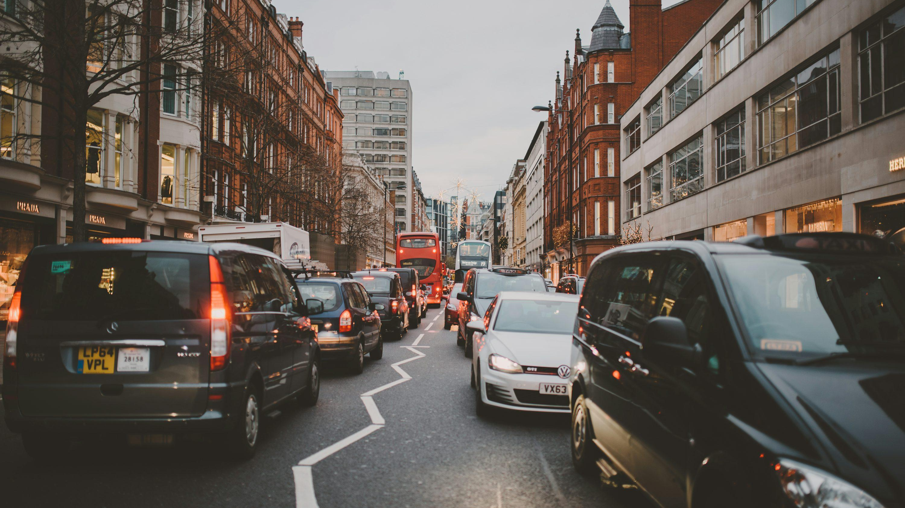
The wrong-road
problem
Why blanket sign-only/default 20mph and Low Traffic Neighbourhoods need a more targeted approach in London
A user-friendly briefing based on London crash data and UK policy evidence
Strategic roads are not residential side streets.
1
Notes:
Speaker notes
- Open with the core distinction: this is not an attack on lower urban speeds in principle.
- It is a challenge to blanket, sign-only/default 20mph and broad one-size-fits-all street policy on the wrong roads.
- Promise the audience a guided tour: first the road question, then the London evidence, then the policy alternative.
[Sources]
- User-provided working paper: traffic_safety_paper.pdf (London road-safety white paper draft, 2026).
- Photo asset: traffic_photo.jpg (user-provided local asset).

Slide 2
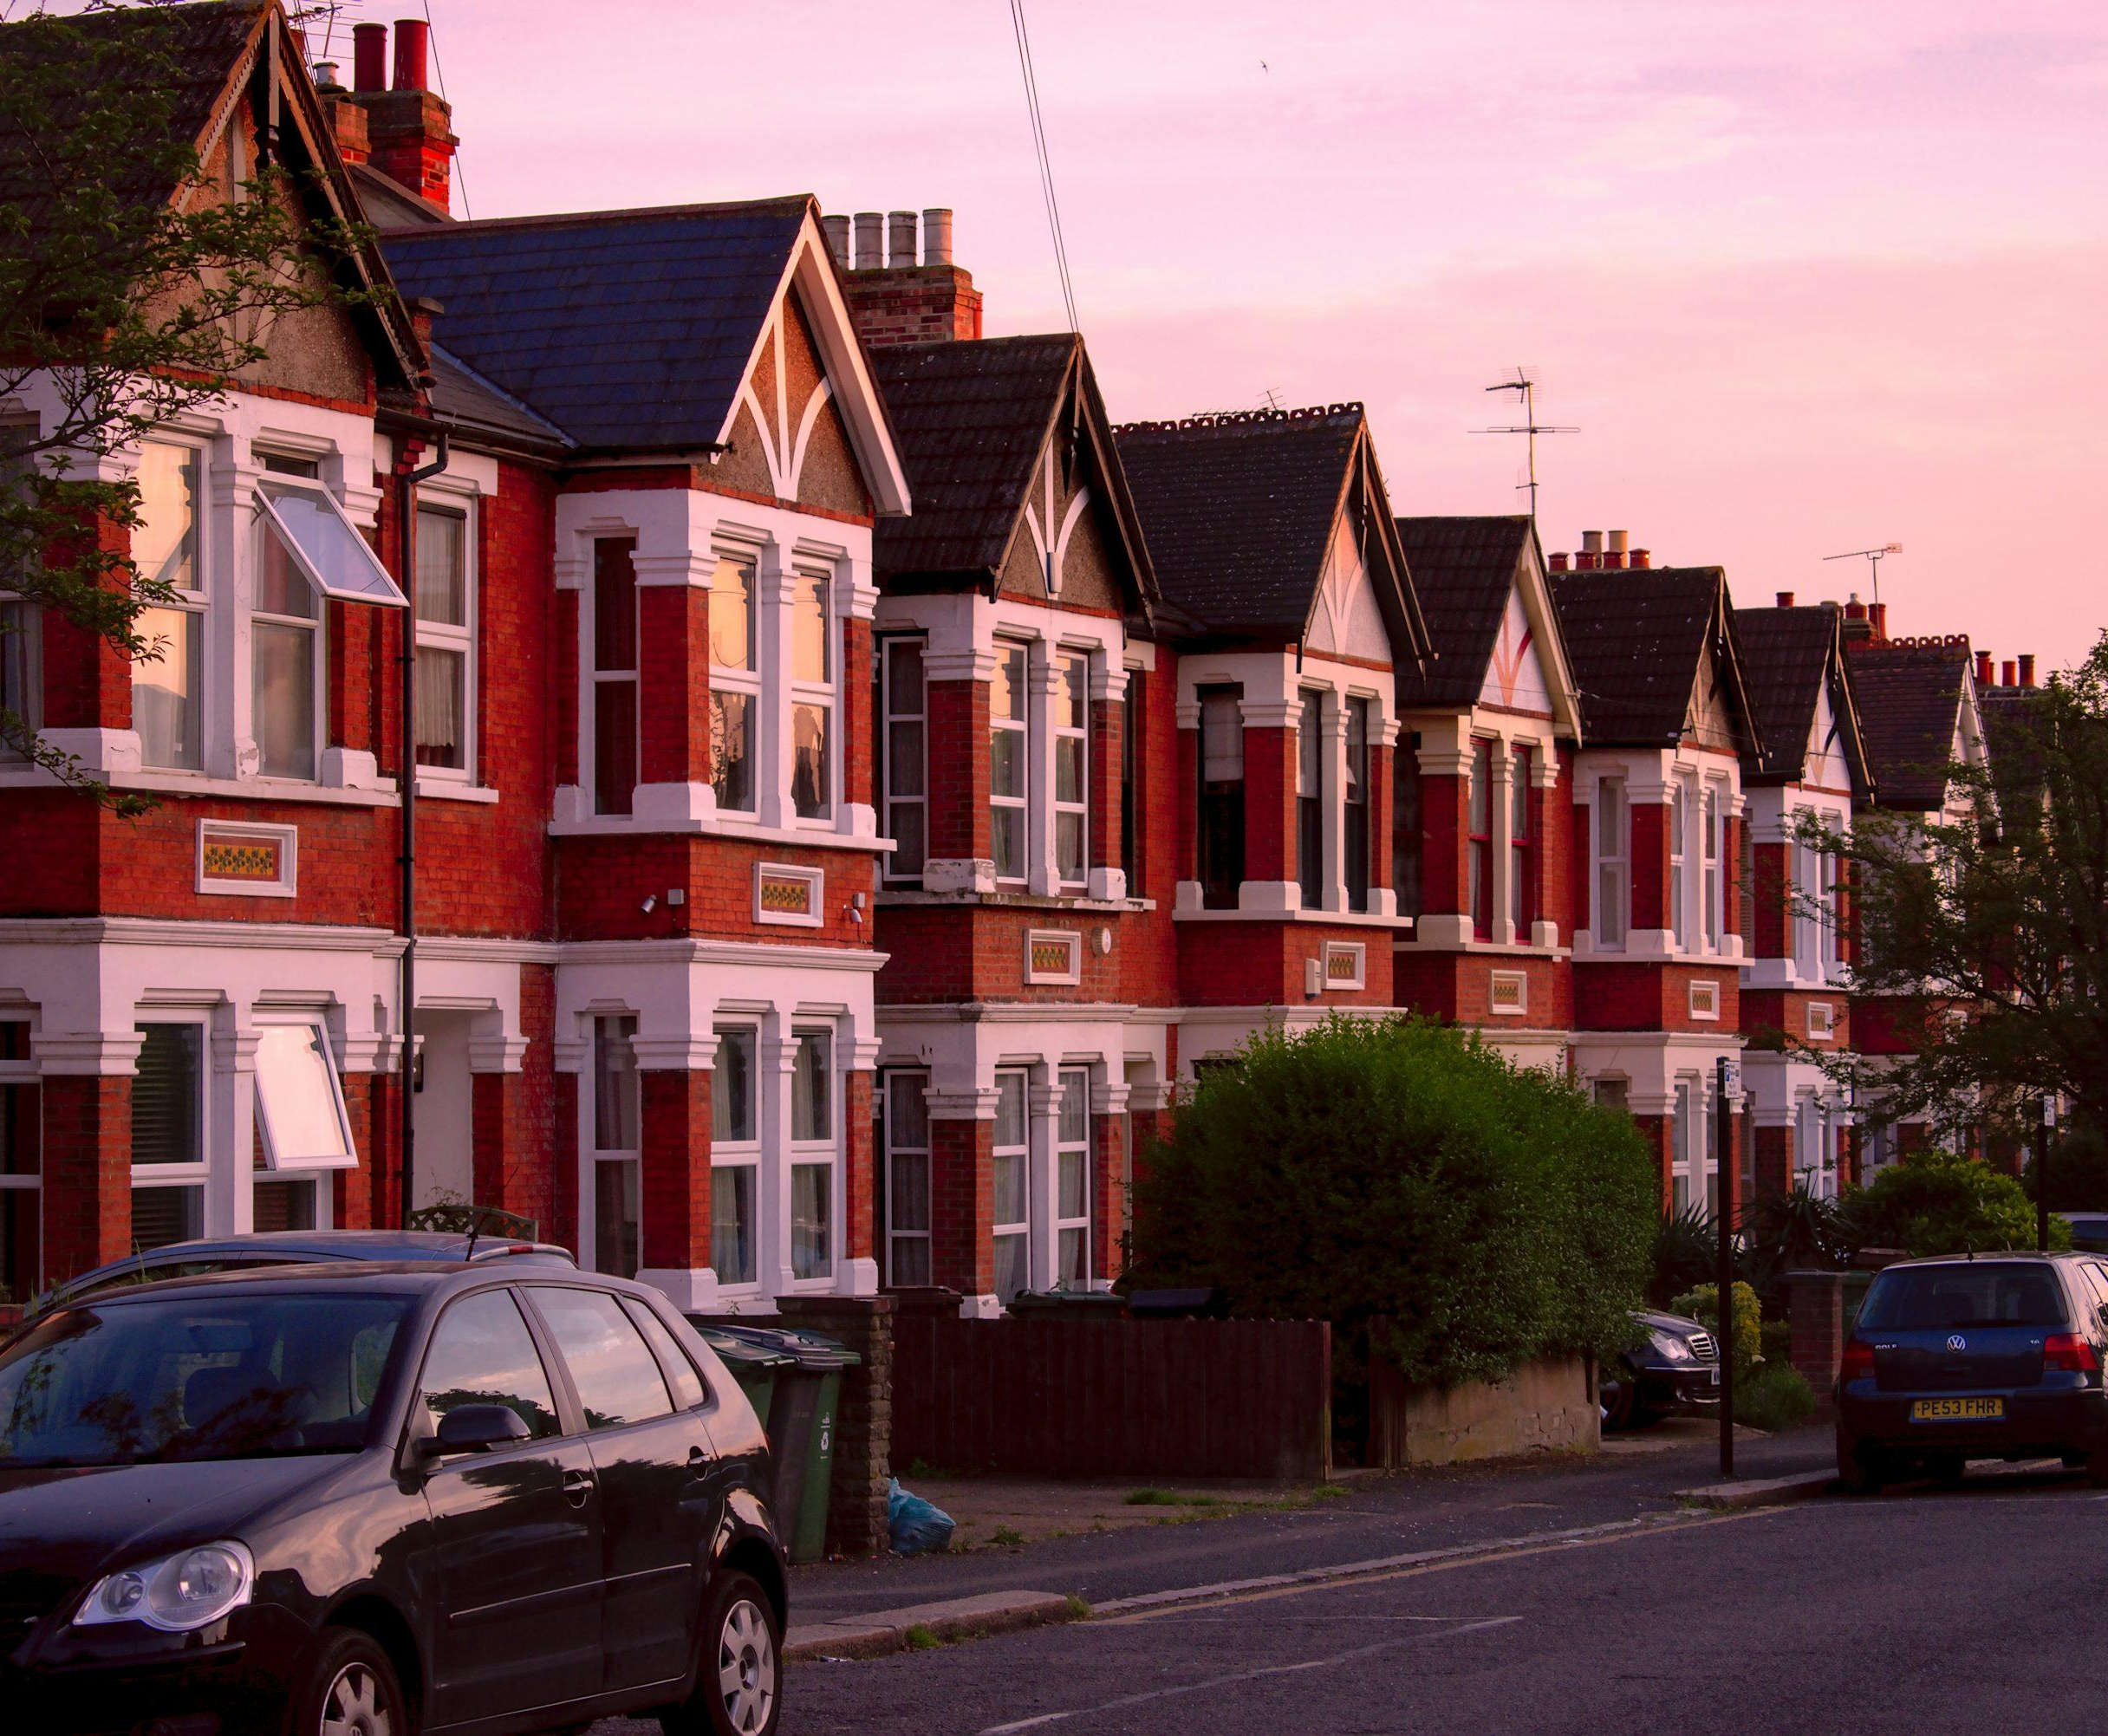
Start with a simple question
Should a quiet local street and a strategic through-route really be treated the same way?
Quiet local street
Strategic route
● homes and schools nearby
● local access matters most
● roads already tend to feel slow
● buses, deliveries and through traffic
● major junctions and queue points
● roads still look and feel like corridors
Our case is simple: London should stop treating these roads as if they were the same.
2
Notes:
Speaker notes
- Use this slide to make the audience picture two very different road types.
- A quiet local street and a strategic through-route should not automatically get the same policy treatment.
- That road-function mismatch is the thread running through the rest of the deck.
[Sources]
- User-provided working paper: traffic_safety_paper.pdf (London road-safety white paper draft, 2026).
- Photo asset: residential_photo.jpg (user-provided local asset).
- Photo asset: traffic_photo.jpg (user-provided local asset).

Slide 3
How to read this briefing
You do not need to know the paper. We will define the key terms and walk through the argument step by step.
1. What we checked
2. What we found
3. What London should do
We start with one question: are the raw headline numbers telling the full story, or do they hide important differences between road types and locations?
Once the checks are applied, the story becomes more mixed. The strongest concerns cluster on main roads, junctions, crossings and other conflict-heavy places.
Move away from one-size-fits-all defaults. Keep lower limits where the street environment supports them, but treat strategic corridors separately.
Three steps: understand the road, check the evidence, then ask what policy actually fits.
3
Notes:
Speaker notes
- This slide sets the ground rules: we are guiding the audience and not assuming they have read the paper.
- Tell them the flow explicitly: road question first, evidence second, policy answer third.
- Reassure them that the appendix contains the technical detail if they want it later.
[Sources]
- User-provided working paper: traffic_safety_paper.pdf (London road-safety white paper draft, 2026).

Slide 4
If you remember only three things
Technical detail is in the appendix. The main story is about the wrong roads getting the wrong treatment.
Low Traffic Neighbourhoods (LTNs)
Blanket 20mph
Better policy
Once we correct the raw before-and-after numbers for statistical noise, only one of the four London areas still shows a clear inside-area reduction. The picture is mixed, not a blanket citywide win.
We do not find a robust safety win in any tested road setting. The places that look worst are main roads and conflict-heavy locations, not quiet back streets.
Road by road design, engineering, and route-specific decisions beat one-size-fits-all statutory limits.
The main message is not “20mph is bad.” It is “blanket sign-only/default 20mph is the wrong tool on the wrong roads.”
4
Notes:
Speaker notes
- Give the whole case in one minute here.
- First: the Low Traffic Neighbourhood story becomes mixed once the raw numbers are corrected.
- Second: blanket 20mph shows no robust win in the settings that matter most.
- Third: London needs road-by-road policy, not one-size-fits-all statutory defaults.
[Sources]
- User-provided working paper: traffic_safety_paper.pdf (London road-safety white paper draft, 2026).

Slide 5
How we tested the Low Traffic Neighbourhood claim
Before trusting the headline numbers, we asked three simple questions.
1
What changed at first glance?
2
Was the pre-period unusually bad by chance?
3
Did the change happen inside the area itself?
Start with the simple before-and-after change in recorded injury crashes. Easy to understand — but easy to over-read.
Correct for the possibility that the “before” period caught a random bad spike that would have improved anyway. This is the regression-to-the-mean check.
Compare roads inside the scheme with nearby roads and the rest of the borough. That helps separate an inside-area effect from a broader trend.
In plain English: we did not take the raw before-and-after number at face value.
This is why a dramatic raw gain or loss is not enough on its own.
5
Notes:
Speaker notes
- This slide is the bridge that was missing before: explain the test before showing the result.
- Walk the audience through the three questions in plain English.
- The key point is simple: we did not treat the raw before-and-after number as the whole story.
[Sources]
- User-provided working paper: traffic_safety_paper.pdf (London road-safety white paper draft, 2026).

Slide 6
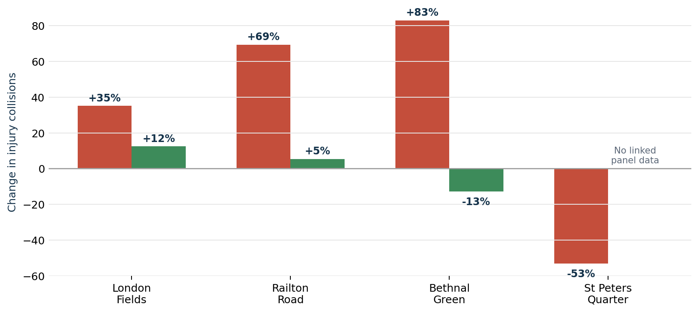
Low Traffic Neighbourhoods: once we checked more carefully, the picture was mixed
Red bars show the raw before-and-after picture. Green bars show the corrected estimate after checking for random spikes.
London Fields
Only zone with a clear inside-area reduction in the corrected picture.
Railton Road
No clear inside-area change once the raw swing is corrected.
Bethnal Green
No clear inside-area reduction in the separate inside-area check.
St Peters Quarter
Not enough linked data for the full corrected test.
Once we correct for noise, the Low Traffic Neighbourhood story is mixed — not a blanket citywide success.
6
Notes:
Speaker notes
- The chart makes the point visually: the raw swings are dramatic, but the corrected picture is much smaller and more mixed.
- Emphasise that only London Fields still shows a clear inside-area reduction in the corrected picture.
- The audience does not need the full technical formula here — only the logic of the correction.
[Sources]
- User-provided working paper: traffic_safety_paper.pdf (London road-safety white paper draft, 2026).
- Chart asset derived from the user paper data: ltn_naive_corrected.png.

Slide 7
How we tested blanket 20mph
This was not a clean before-and-after policy experiment, so we checked the evidence several ways.
1
Check 1: compare broad settings
2
Check 2: ask how severe recorded crashes looked
We compared boroughs that already had a broad 20mph approach with boroughs that still had broader 30mph defaults. This is useful context — but not clean proof on its own.
We looked at whether recorded injury crashes on 20mph roads were more or less likely to end in death or serious injury.
3
Check 3: split roads by setting
4
Check 4: only keep results that still stand out after many comparisons
We separated main roads, junctions, crossings, one-way streets, school-hour roads and other settings, instead of pretending all 20mph roads are the same.
We tested 14 settings. Only the settings that still stood out after that correction are treated as meaningful signals.
Important limit: this compares existing settings in 2020–2024. It does not tell us cleanly what a newly changed road would do.
In short: several checks, but still an associational comparison — not a pure before-and-after experiment.
7
Notes:
Speaker notes
- This is the 20mph equivalent of the LTN methods bridge.
- The audience needs to hear two things: we checked the evidence several ways, and this is still not a clean policy-before-and-after experiment.
- That makes the argument more credible, not weaker.
[Sources]
- User-provided working paper: traffic_safety_paper.pdf (London road-safety white paper draft, 2026).

Slide 8
Where blanket 20mph looked worst in our sample
We checked 14 road settings. After that, four still stood out.
What the chart shows
Most important takeaway
Higher values mean a higher share of recorded injury crashes ending in death or serious injury on 20mph roads.
No road setting showed a robust improvement after checking many comparisons.
A-roads
+1.78
Near pedestrian crossings
+1.48
Single carriageways
+0.85
Why this matters
These are not quiet back streets. They are exactly the places where a weak sign-only treatment is least likely to fit the road.
At junctions
+0.82
Definition in plain English
“Fatal-or-serious-injury share” means the share of recorded injury crashes that ended in death or serious injury.
The strongest concerns sit on main roads and conflict-heavy locations — not on quiet local streets.
8
Notes:
Speaker notes
- This is the most important 20mph slide in the main deck.
- Explain the measure in plain English before interpreting the bars.
- Then make the big point: the settings that still look worst are main roads, junction-heavy places and crossings — the roads least suited to blanket sign-only/default treatment.
[Sources]
- User-provided working paper: traffic_safety_paper.pdf (London road-safety white paper draft, 2026).

Slide 9
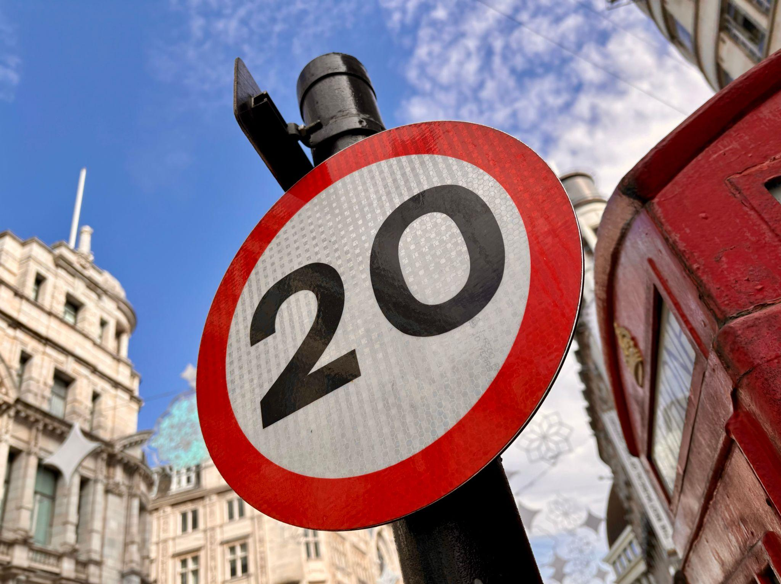
This is the wrong-road problem
The issue is not lower speeds in principle. It is using a weak, sign-only treatment on roads that do not naturally behave like 20mph roads.
1
Department for Transport guidance
2
Sign-only schemes
3
Core insight
20mph should be used road by road, and successful schemes are generally self-enforcing. Through-routes need special consideration.
The Department for Transport’s 2018 evaluation found a median speed change of less than 1 mph for sign-only schemes.
If the road still looks and feels like a corridor, a sign alone is a weak treatment.
Road character often matters more than the number on the sign.
This is why the issue is not simply “20mph” — it is the wrong treatment on the wrong roads.
9
Notes:
Speaker notes
- This slide explains the wrong-road problem in plain English.
- Keep the audience focused on fit, not blame: the issue is a weak sign-only treatment on roads that still behave like corridors.
- Point to the Department for Transport guidance first, then to the sign-only evaluation, then to the core takeaway.
- The image has been removed so the audience can focus on the idea rather than decoration.
[Sources]
- Department for Transport (2013), Setting Local Speed Limits.
- Department for Transport (2018), 20mph Research Study.

Slide 10
Why people feel the drag
We use official Welsh route monitoring for real-world delay and the Welsh appraisal for the long-run cost estimate.
What Transport for Wales monitored
£6.4bn
£1.6bn
Official 30-year journey-time cost estimate in the Welsh appraisal.
Potential business-travel productivity loss in that same official appraisal.
44 slower
(<2 min)
13 slower
(2–4 min)
3
not slower
Transport for Wales compared journey times across 60 route-and-time checks after the default 20mph change.
Why this matters in practice
The Welsh appraisal then converted repeated journey-time loss across many trips into a long-run cost estimate.
Builders fit fewer jobs into a day. Deliveries lose reliability. Bus timetables get harder to hold. Meeting-heavy work becomes harder to schedule.
The per-trip delay may be small. The citywide drag comes from repeating it all day on the wrong roads.
10
Notes:
Speaker notes
- This slide uses two Welsh sources together.
- The monitoring tells us how often routes got slower in practice.
- The appraisal translates repeated journey-time loss into a long-run cost estimate.
- The point is cumulative drag: small delays repeated every day on the wrong roads.
[Sources]
- Transport for Wales (2025), National Monitoring Report.
- Welsh Government / Senedd (2022), Explanatory Memorandum.

Slide 11
Voters notice when the wrong roads get the wrong limit
Support in principle can fade quickly when blanket 20mph is experienced on strategic roads.
Consultation responses (Wales, 2022)
Post-rollout polling (Wales, 2024)
Useful as a signal of mobilised opposition — but remember: this consultation was self-selected.
Broader mood after implementation: support dropped sharply once people experienced the policy on real roads.
53%
against
47%
for
72%
oppose
24%
support
5,607 analysed responses
40% say they exceed the limit most or all of the time
This tells us that blanket 20mph can trigger organised pushback when people feel the wrong roads have been swept in.
Polls do not prove safety effects. They do show a legitimacy and targeting problem when the policy feels misapplied.
The point is not that opinion polls prove safety. The point is that blanket schemes can lose public trust quickly when the wrong roads are included.
11
Notes:
Speaker notes
- This slide is about legitimacy and public buy-in.
- Make the distinction explicit: consultation responses are a self-selected signal of mobilisation; polling is a broader read of public mood after rollout.
- The message is not “people are angry, therefore scrap it.” The message is that poor targeting erodes policy legitimacy.
[Sources]
- User-provided working paper: traffic_safety_paper.pdf (London road-safety white paper draft, 2026).
- Welsh Government (2022), Proposal to reduce speed limit to 20mph on residential streets: summary of responses.
- YouGov (2024), Wales overwhelmingly rejects the 20mph speed limit.

Slide 12
What we are — and are not — saying
This matters because weakly framed criticism gives easy ammunition to defenders of blanket 20mph.
We are not saying…
We are saying…
● lower urban speeds never work
● every 20mph scheme fails
● this London sample proves causality
● one bad corridor means all 20mph roads are wrong
● blanket sign-only/default 20mph is often the wrong tool on strategic roads
● signage is not engineering
● strategic routes need separate treatment
● London needs road-by-road appraisal, not one-size-fits-all defaults
The debate is not “20mph or nothing.” It is “which roads need which treatment?”
12
Notes:
Speaker notes
- Use this slide to block the easiest rebuttals.
- We are not claiming that lower speeds never work or that this dataset proves causality.
- We are claiming that blanket sign-only/default 20mph is often the wrong treatment on strategic roads.
[Sources]
- User-provided working paper: traffic_safety_paper.pdf (London road-safety white paper draft, 2026).

Slide 13
A better plan for London
Move from blanket defaults to targeted, road-by-road decisions — and test a 25mph middle option on selected strategic corridors.
1
Keep residential
20mph
2
Review strategic roads separately
3
Use engineering first
4
Publish route
data
Treat through-routes, bus routes and freight corridors as a different policy category.
Crossings, junctions, signal timing and layout changes do more than a sign alone on busy corridors.
Quiet local streets and school-heavy roads can still justify lower limits where the road already feels slow and local access matters most.
Show route-by-route journey times and business impacts before expanding blanket policies.
Practical ask of City Hall
Pause any further blanket expansion on strategic roads until London publishes route-by-route evidence on delay, business impact and safety trade-offs.
On selected corridors, pilot 25mph as a middle option rather than forcing a blanket 20mph default.
The answer is better targeting: the right roads, the right tools, and proof before expansion.
13
Notes:
Speaker notes
- The policy ask is targeted, not blanket.
- Keep true residential 20mph where the street environment supports it.
- Review strategic roads separately.
- On selected corridors, a 25mph pilot can be tested as a middle option rather than forcing a blanket 20mph default.
[Sources]
- Main paper results.
- DfT guidance and Welsh monitoring/appraisal for policy context.

Slide 14
Bottom line
Blanket 20mph is a one-size-fits-all answer to a road network that is not one-size-fits-all.
Ask of City Hall
Review strategic roads before expanding blanket 20mph further.
Publish route-by-route delay and business-impact evidence.
Pilot 25mph on selected strategic corridors where 20mph is a poor fit.
● Low Traffic Neighbourhoods: once we correct for noise, the picture is mixed.
● Blanket 20mph: no robust improvement appears in the most important tested settings.
● London should target the right roads with the right tools — not default to blanket statutory limits.
14
Notes:
Speaker notes
- End on three points: mixed Low Traffic Neighbourhood picture, no robust 20mph gain in the most important tested settings, and better targeting for London.
- Mention the 25mph pilot only as a route-by-route middle option on selected corridors.
[Sources]
- Main paper results.

Slide 15
Appendix: technical detail starts here
Only here if you need more detail. The next slides define the terms and show the checks in plain English.
Low Traffic Neighbourhoods (LTNs)
20mph comparison
1. Simple before-and-after check
2. Check for a random pre-period spike
3. Compare roads inside the area with nearby roads and the rest of the borough
1. Broad setting comparison
2. Severe-crash likelihood check
3. Road-setting split
4. Boundary comparison
5. 14-setting check with multiple-comparison correction
Why this appendix exists: so the public story stays simple without hiding the technical checks.
15
Notes:
Speaker notes
- Tell the audience that everything after this point is backup material.
- The appendix is there to show that the simple public story rests on several checks, and that the main technical terms can be explained in plain English.
[Sources]
- User-provided working paper: traffic_safety_paper.pdf (London road-safety white paper draft, 2026).

Slide 16
Appendix: key terms in plain English
These are the technical ideas behind the simple story.
Low Traffic Neighbourhood (LTN)
Fatal-or-serious-injury share
Cross-sectional / associational
A residential area where through-traffic is restricted so local streets work more like local streets and less like cut-through routes.
The share of recorded injury crashes that ended in death or serious injury. Useful for comparing crash mix, but not the same as risk per trip.
A comparison of settings that already existed. It can show patterns, but not a clean before-and-after causal effect.
Regression to the mean
Multiple-comparison correction
A temporary spike often falls back on its own. That is why raw before-and-after numbers can exaggerate policy effects if the “before” period happened to be unusually bad.
If you test many road settings, some will look unusual by chance alone. We only treat the settings that still stand out after that correction as meaningful signals.
Two key ideas to remember: raw spikes can mislead, and “share” is not the same as risk per trip.
16
Notes:
Speaker notes
- This slide defines the main terms in plain English.
- Keep it short and focus on the two most important ideas: regression to the mean, and the fact that fatal-or-serious-injury share is not the same as risk per trip.
[Sources]
- User-provided working paper: traffic_safety_paper.pdf (London road-safety white paper draft, 2026).

Slide 17
Appendix: what the main numbers do — and do not — mean
This is the key technical caveat behind the 20mph debate.
Injury-crash count
Fatal-or-serious-injury count
Fatal-or-serious-injury share
How many police-recorded injury crashes happened in a place or period.
How many of those recorded injury crashes involved death or serious injury.
The severe share of recorded injury crashes. Useful, but not the same as risk per trip, per mile or per vehicle-mile.
Why that matters
A higher severe share could mean genuinely worse severe outcomes. But it could also mean fewer minor crashes while severe crashes stay unchanged. That is why share cannot settle the whole safety argument on its own.
This is why we use “fatal-or-serious-injury share” carefully: it is a clue about crash mix, not a full measure of exposure-adjusted risk.
17
Notes:
Speaker notes
- This is the key measurement caveat.
- A higher fatal-or-serious-injury share could mean worse severe outcomes, but it could also mean fewer minor crashes with severe crashes unchanged.
- That is why the paper avoids claiming that share alone settles the safety question.
[Sources]
- User-provided working paper: traffic_safety_paper.pdf (London road-safety white paper draft, 2026).

Slide 18
Appendix: Low Traffic Neighbourhood test in plain English
Why the simple before-and-after story was not enough.
Step 1 | What changed at first glance?
Step 2 | Was the “before” period just unusually bad?
Step 3 | Did the change happen inside the area itself?
Start with the raw before-and-after change in recorded injury crashes. This is the easy headline number — but it can swing wildly.
Correct for the possibility that the pre-period was a temporary bad spike that would have improved anyway. That is the regression-to-the-mean step.
Compare roads inside the scheme with nearby roads and the rest of the borough. That helps separate an inside-area effect from a broader trend.
Result in plain English: only London Fields still showed a clear inside-area reduction after the full set of checks.
18
Notes:
Speaker notes
- Walk through the Low Traffic Neighbourhood test as a three-step filter.
- This is the slide that should answer the old “adjust for random spikes” confusion: say explicitly that the question is whether the bad pre-period would have improved anyway.
- End with the plain-English result.
[Sources]
- User-provided working paper: traffic_safety_paper.pdf (London road-safety white paper draft, 2026).

Slide 19
Appendix: how the 20mph test worked
This was a comparison of existing settings, not a clean policy-before-and-after experiment.
What we checked
What this can say
1. Broad borough comparison
2. Severe-crash likelihood check
3. Road-setting split
4. Boundary comparison
5. 14-setting check with multiple-comparison correction
It can show where 20mph roads looked better or worse in this sample once similar contexts were compared more carefully.
What this cannot say
It cannot tell us cleanly what would happen if a road newly changed from 30mph to 20mph, because the borough-wide regime was already in place before the study window.
Main technical takeaway: none of the 14 tested settings showed a robust beneficial signal after correction.
19
Notes:
Speaker notes
- Explain that the 20mph analysis uses several checks because no single comparison is enough.
- Then state the key limitation plainly: the policy was already in place before the study window, so this is a comparison of existing settings rather than a clean before-and-after experiment.
- The main signal is still strong: no robust beneficial setting after correction.
[Sources]
- User-provided working paper: traffic_safety_paper.pdf (London road-safety white paper draft, 2026).

Slide 20
Appendix chart: Low Traffic Neighbourhood numbers at a glance
This compares the raw before-and-after picture with the corrected picture and the inside-area check.
Zone | Inside-area check | Boundary-road check
London Fields | Clear reduction (-0.75, p<0.001) | No worsening on boundary roads (-0.95, p<0.001)
Railton Road | No clear inside-area change (-0.15, p=0.434) | Boundary estimate is negative (-0.41, p=0.003)
Bethnal Green | No clear inside-area change (+0.76, p=0.665) | Boundary estimate is negative (-0.85, p<0.001)
St Peters Quarter is omitted because the linked data were not strong enough for the corrected and inside-area checks.
20
Notes:
Speaker notes
- This is the technical backup for the Low Traffic Neighbourhood section.
- The chart shows why raw before-and-after numbers can mislead: the corrected picture is smaller and more mixed than the headline swing.
- Use the table to answer questions about the separate inside-area and boundary-road checks.
[Sources]
- User-provided working paper: traffic_safety_paper.pdf (London road-safety white paper draft, 2026).
- Chart asset derived from the user paper data: ltn_naive_corrected.png.

Slide 21
Appendix chart: 20mph results by road setting
Positive values mean a higher fatal-or-serious-injury share on 20mph roads in that setting.
Setting | Difference | Still stood out after the many-comparisons check?
A-roads | +1.78 | Yes
Near pedestrian crossings | +1.48 | Yes
Single carriageways | +0.85 | Yes
At junctions | +0.82 | Yes
Unclassified roads | -0.86 | No
C-roads | -0.44 | No
A-roads
+1.78
Near pedestrian crossings
+1.48
School hours
+0.87
Single carriageways
+0.85
At junctions
+0.82
One-way streets
+0.78
Daylight
+0.63
Unclassified roads
-0.86
C-roads
-0.44
No road setting showed a robust improvement after checking many comparisons.
21
Notes:
Speaker notes
- This slide puts the 20mph context results in one place.
- The main point is that the strongest adverse associations are on the roads where blanket sign-only/default 20mph is least likely to fit well.
- Also point out that the negative signals on quieter road types do not survive the many-comparisons check.
[Sources]
- User-provided working paper: traffic_safety_paper.pdf (London road-safety white paper draft, 2026).

Slide 22
Appendix chart: how delay assumptions change the cost
Illustrative annual cost per zone using the paper’s economic model. This is a sensitivity exercise, not measured journey-time data.
Medium-traffic boundary road
(15,000 vehicles per day)
Boundary scenario | Delay per vehicle | Annual drag (£m)
7,500 vehicles/day | 0.5 min | 2.5
15,000 vehicles/day | 1.0 min | 10.3
15,000 vehicles/day | 2.0 min | 20.6
30,000 vehicles/day | 4.0 min | 82.4
41.2
20.6
10.3
5.1
Annual cost (£m)
0.5 min
1.0 min
2.0 min
4.0 min
What to remember
The point is cumulative drag: small repeated delays on strategic roads can add up to meaningful citywide cost.
22
Notes:
Speaker notes
- This slide translates the economic appendix into a simple picture.
- The point is not one dramatic queue. It is repeated small delays across a city economy.
- Remind the audience that these figures are illustrative and depend heavily on the delay assumption.
[Sources]
- User-provided working paper: traffic_safety_paper.pdf (London road-safety white paper draft, 2026).

Slide 23
Appendix chart: why 25mph is being raised
This is a policy hypothesis, not a finding proven by the study. Measure shown here = the share of recorded injury crashes that ended in death or serious injury.
Fatal-or-serious-injury share by posted speed
Posted speed | Severe-share value | What it does not prove
20mph | 15.9% | Different road mix
30mph | 15.3% | Different traffic mix
40–50mph | 15.1–15.8% | Different location types
60–70mph | 16.1–18.1% | Small volumes at top end
Measure shown: severe-crash share (%)
18.5%
17.6%
16.6%
15.6%
14.7%
20
30
40
50
60
70
Why this is only a hypothesis
These speed groups mix very different road types and traffic conditions. The 25mph point is about testing a middle option on selected corridors — not claiming this chart proves the answer.
23
Notes:
Speaker notes
- This slide is only a policy hypothesis.
- Explain the measurement clearly: it shows the share of recorded injury crashes ending in death or serious injury.
- The chart does not prove that 25mph is optimal.
- It only supports testing a middle option on selected strategic corridors where 20mph appears to be a poor fit and 30mph may be too high.
[Sources]
- Main paper descriptive chart.
- Policy interpretation from the white paper.

